Slide 1
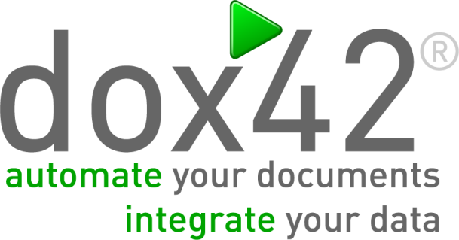



SharePoint Document Automation in the cloud Generate PDFs, Words, Presentations and Mails the way you love it!
Christian Bauer CEO | Software Architect | Denise Valentin Business Technology Evangelist

Slide 2

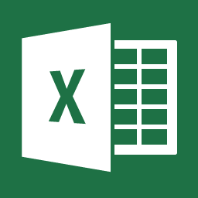

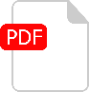
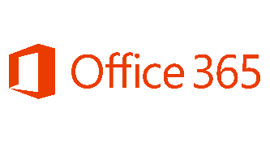

































Innovative Software Product for Document Generation | Intuitive Design for Complex Documents in
Document Output | Flexible Integration
www.dox42.com
300
Customers
80
Partners
HQ
Vienna

Slide 3

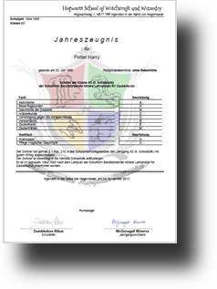
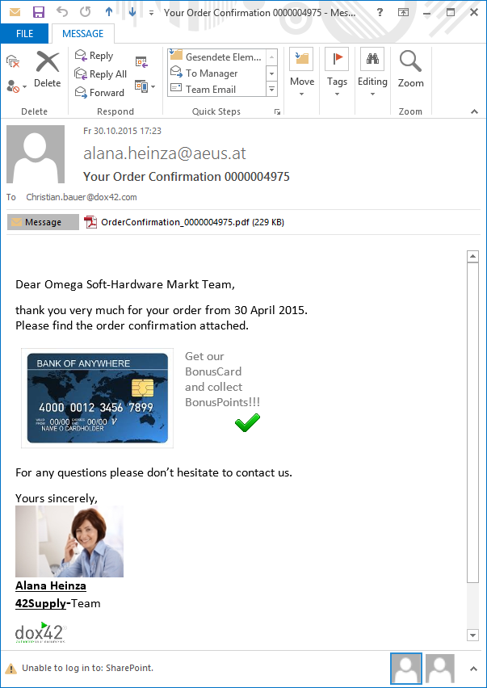
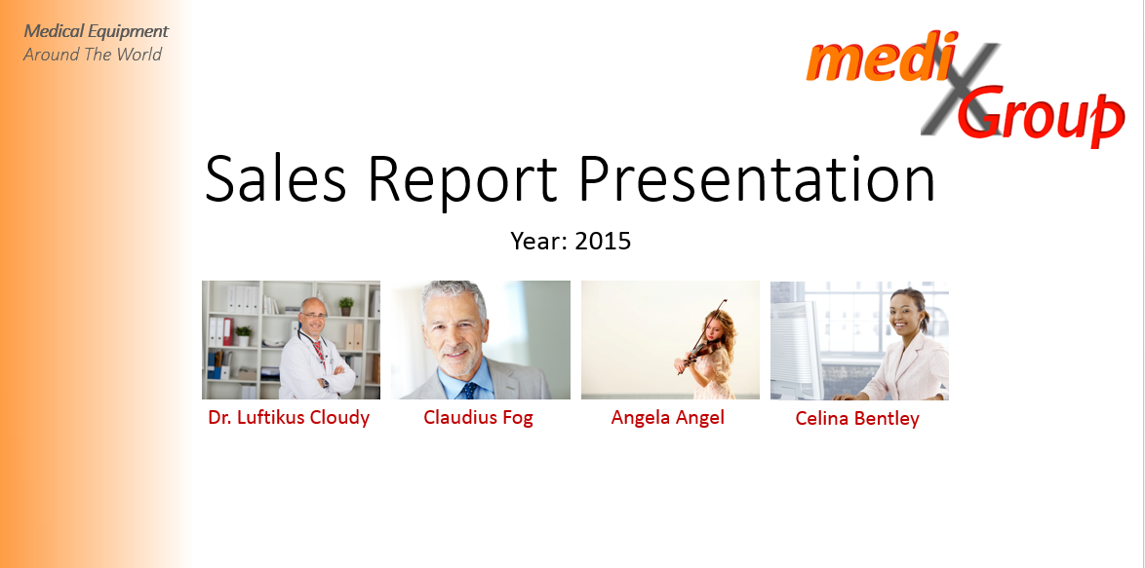
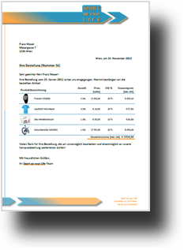
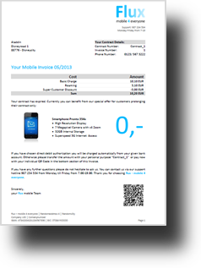
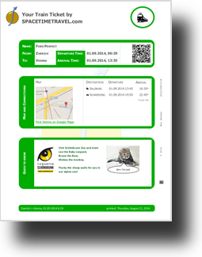
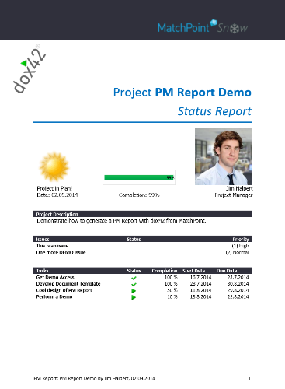
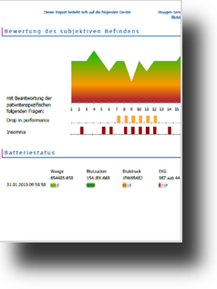

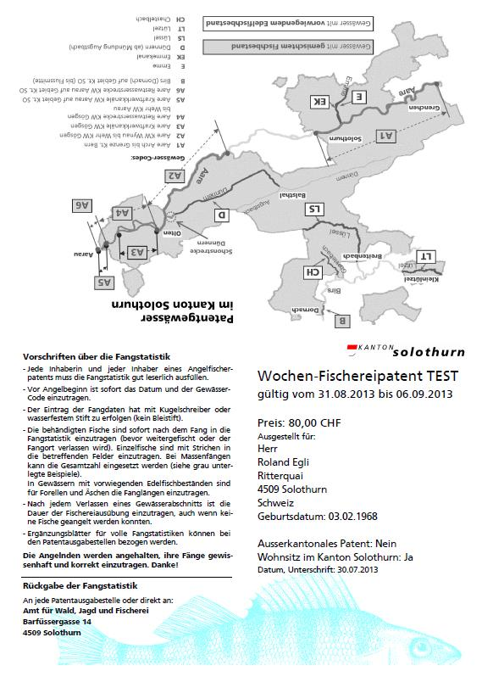
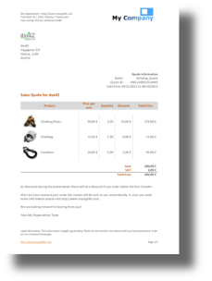
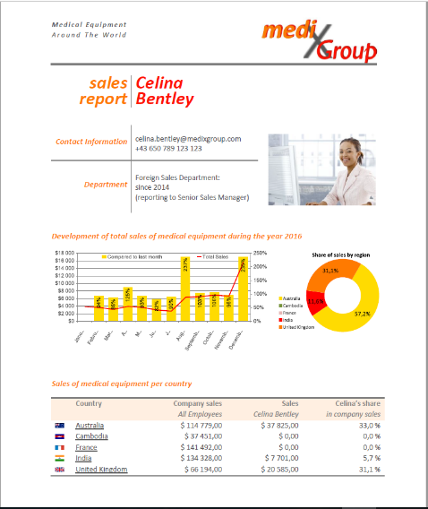
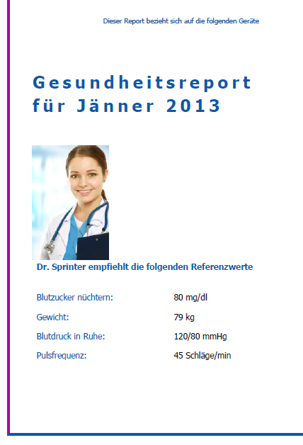
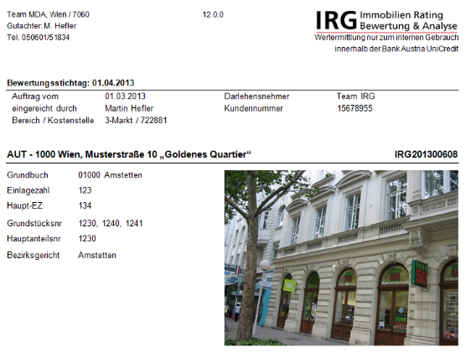

Structured Documents?

Slide 4


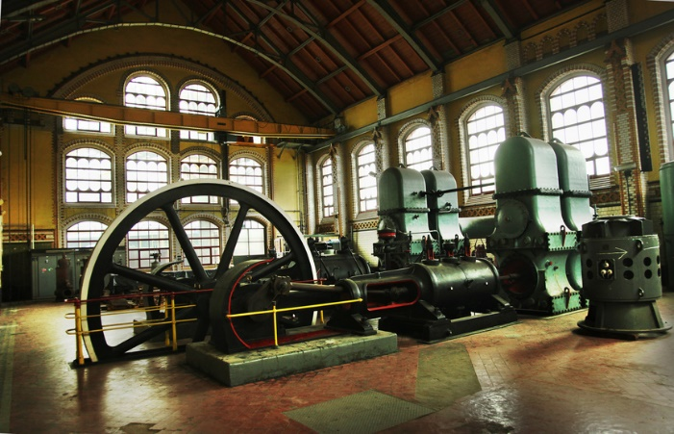

Document Creation in real Business Life
Copy/Paste
Flexible, Individual
Costly
Cumbersome
Error prone
Slow
9 to 5
Stress!
Application or SSRS
Server Side Automation
7x24
Performance
Flexible+Individual? No more!
„Ugly“ Documents
Data Integration?
Corporate Design by IT
VBA, VSTO, Apps
Flexible, Individual
Automation
Error Reduction
Low Numbers
Only Client, 9 to 5
Adaptability?
Dead End

Slide 5


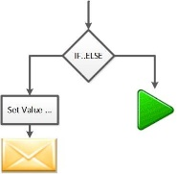
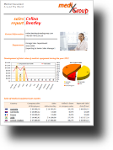
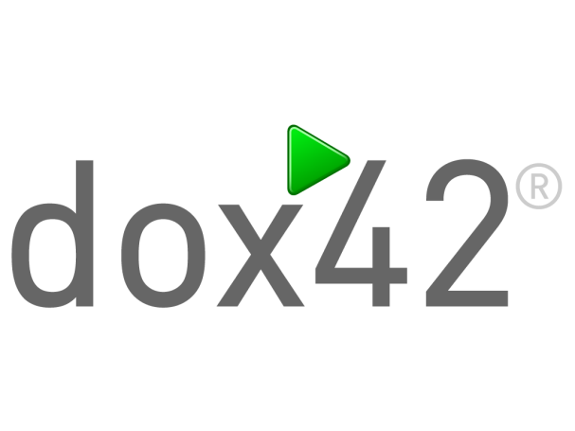
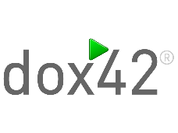
Dokumente automatisieren, Daten integrieren
Flexibel, mächtig und intuitiv
Calibri .
IT
Marketing
Business
Automate your documents, integrate your data
Flexible, powerful and intuitive

Slide 6

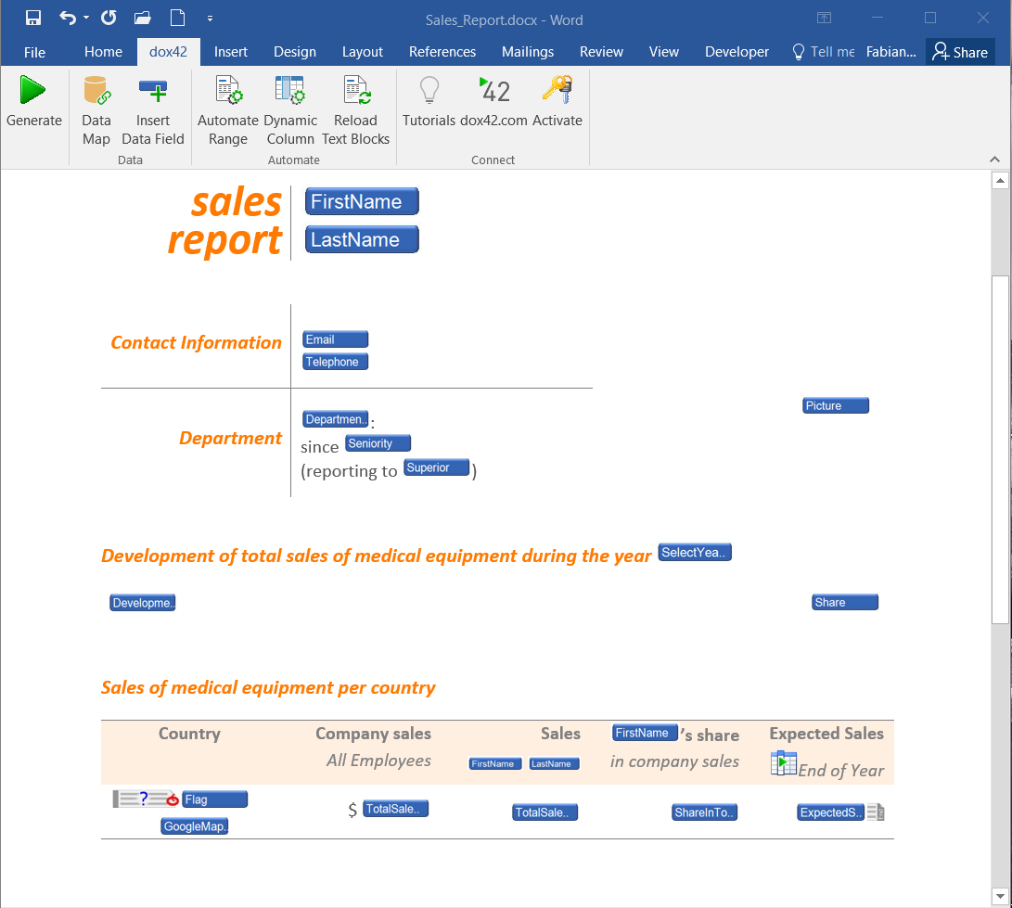
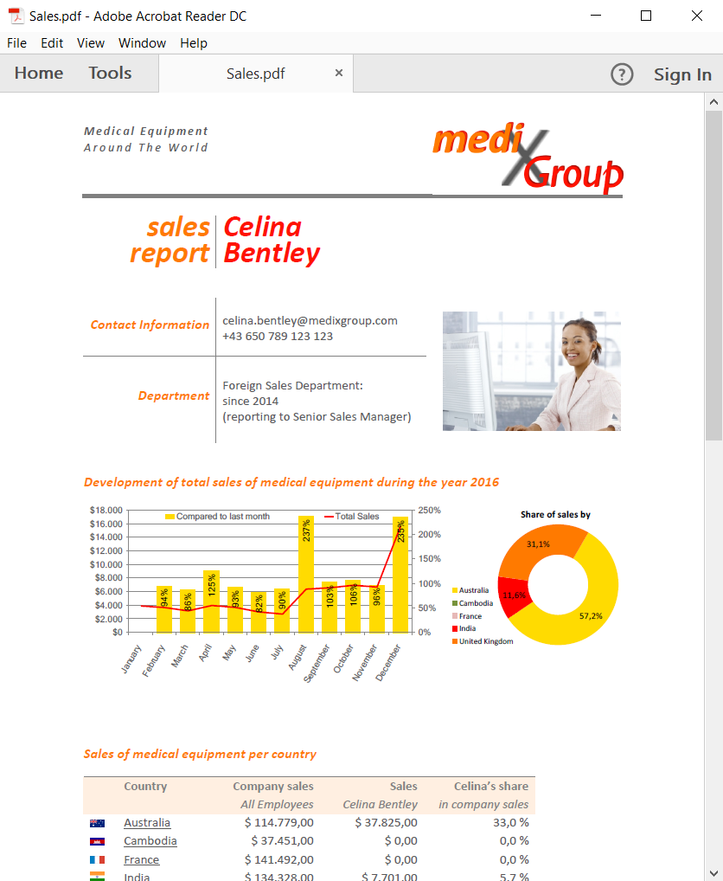
Template design in Microsoft® Office Generate documents from your application

Slide 7






Data Base
Custom
WebService
MS Dynamics 365
CRM, NAV, AX Online & on Prem
SharePoint
XML/JSON
Office 365 & on Prem
Integrate data from various sources without programming

Slide 8

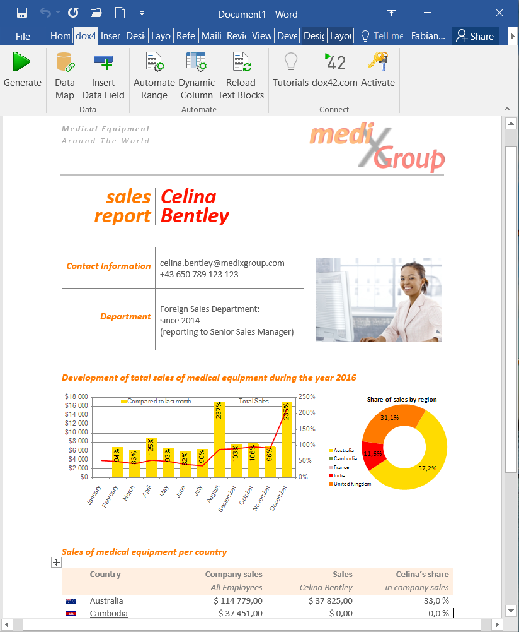
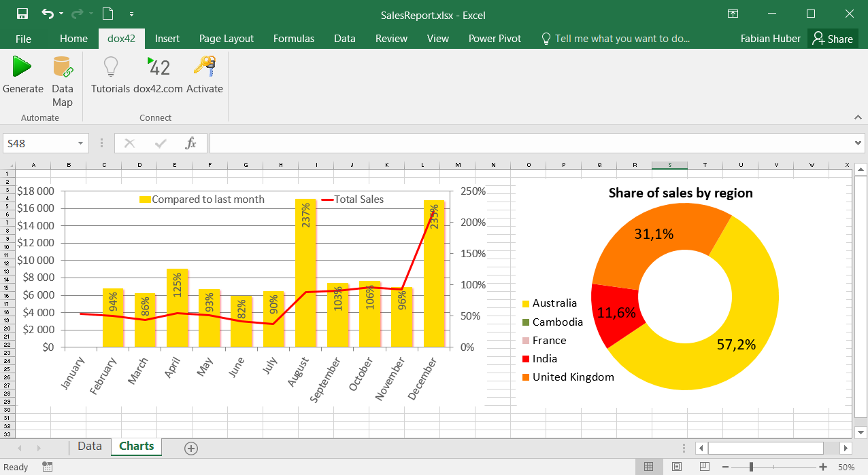
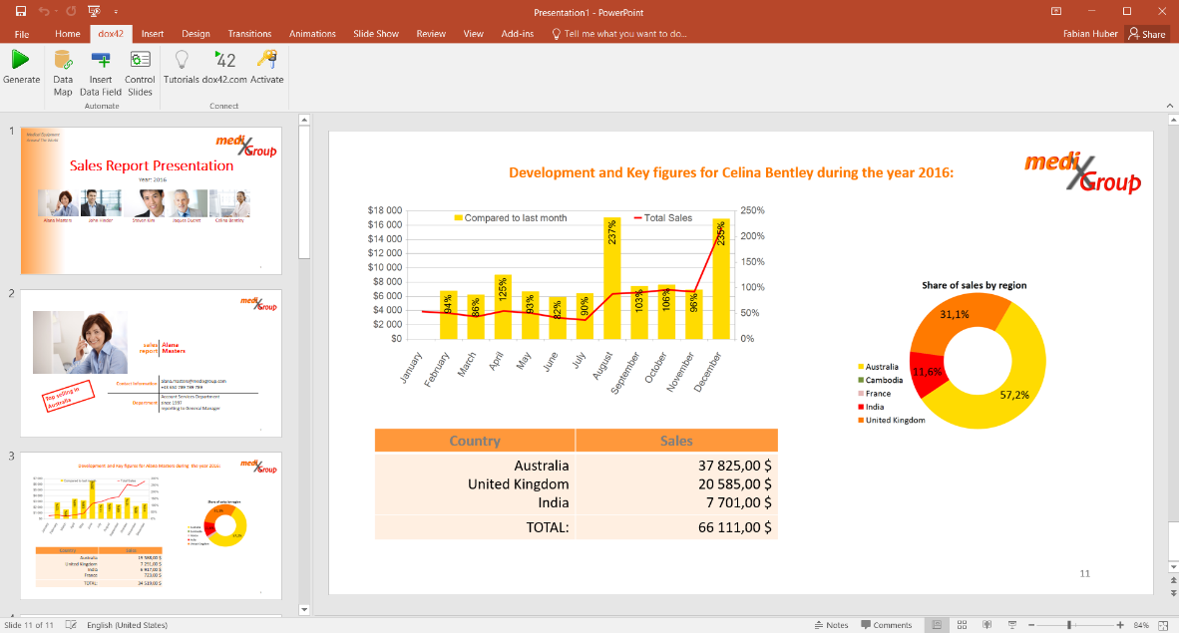
Automate Excel as calculation and charting engine
Notes:
symbol

Slide 9
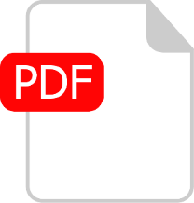






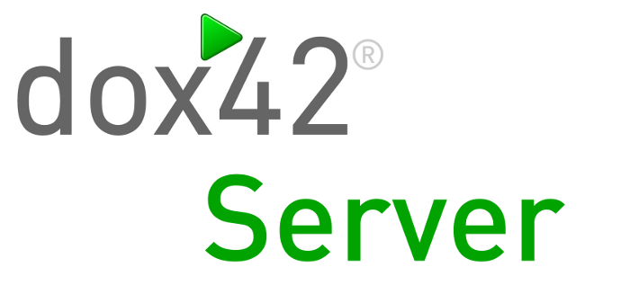

PDF/A
Mail
SMS
Images
<HTML>
Automate your Output Management

Slide 10

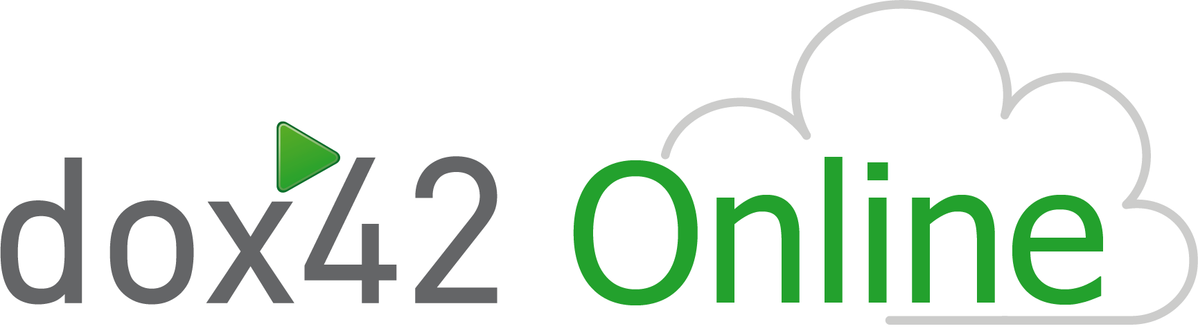







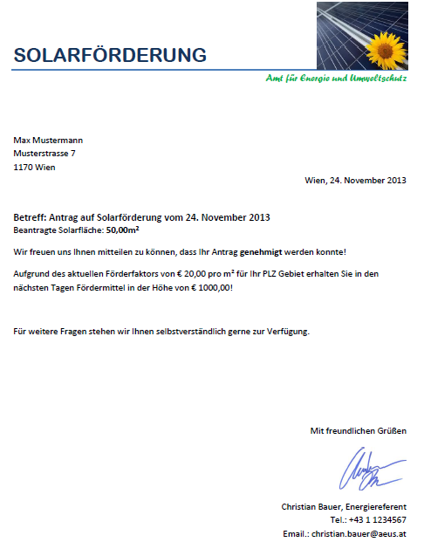
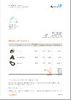

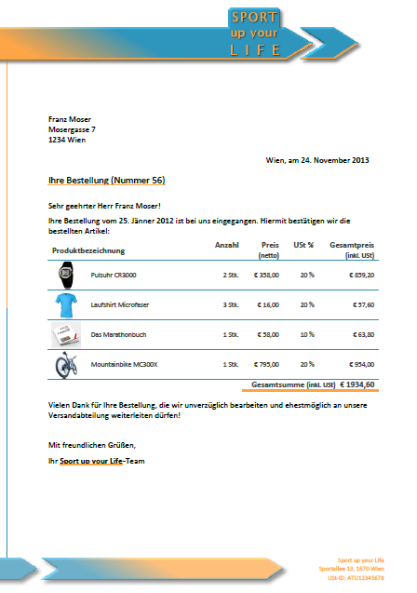
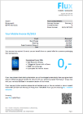


The Cloud
All dox42 server functions as Software as a Service
Azure AD impersonation: no data visible on the server
100.000 documents per month

Slide 11
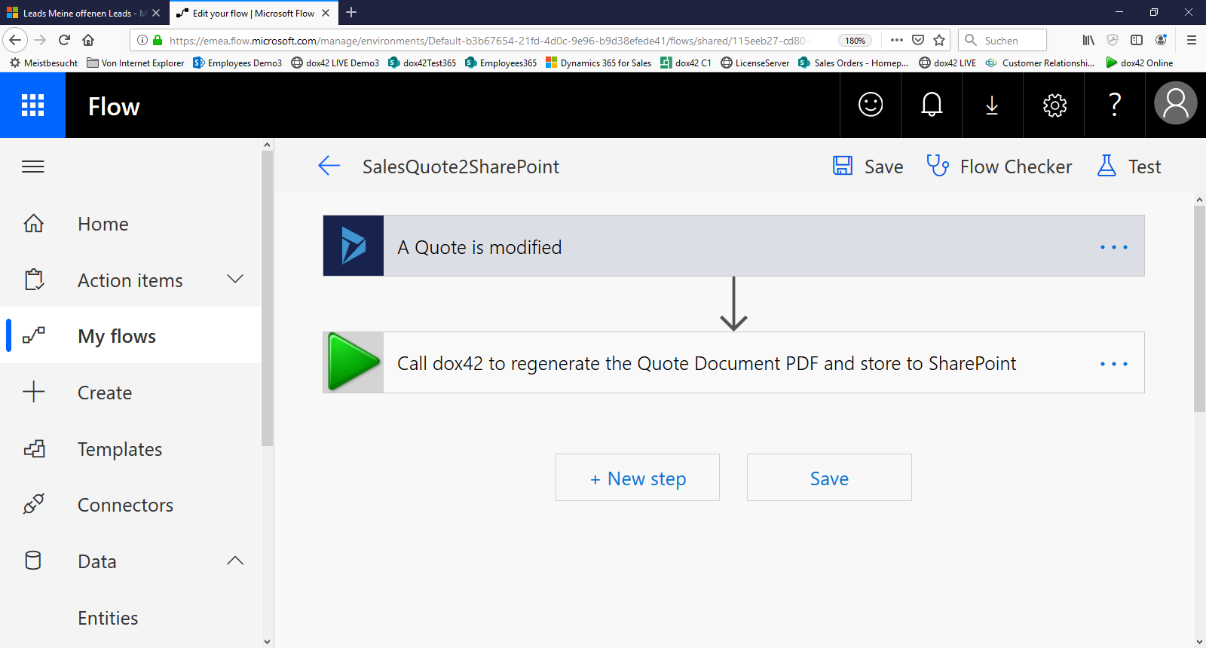

dox42 and MS Flow or Business Processes

Slide 12
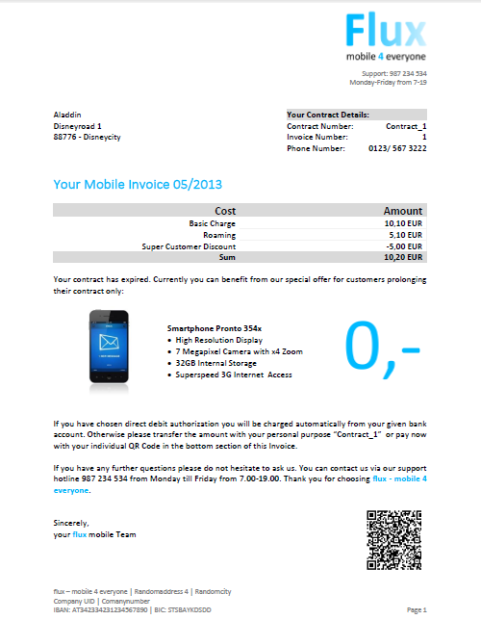
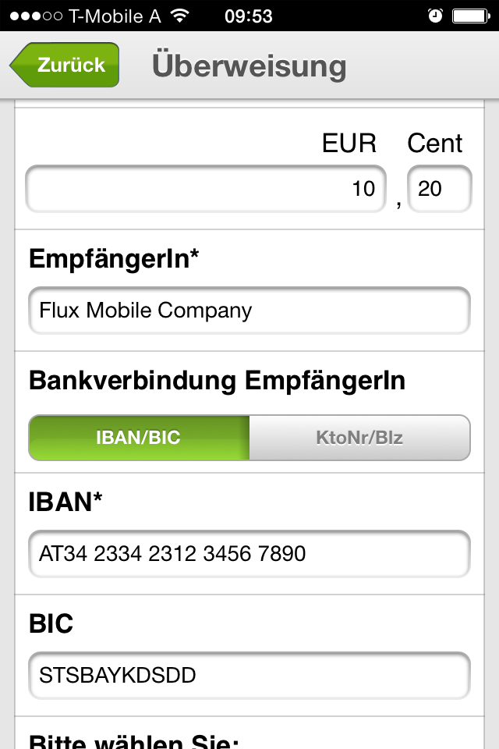
QR-codes, bar-codes

Slide 13



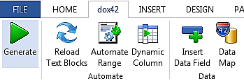
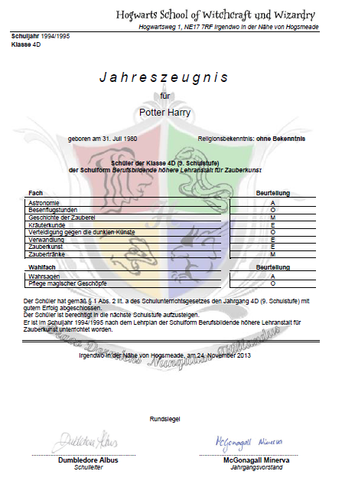

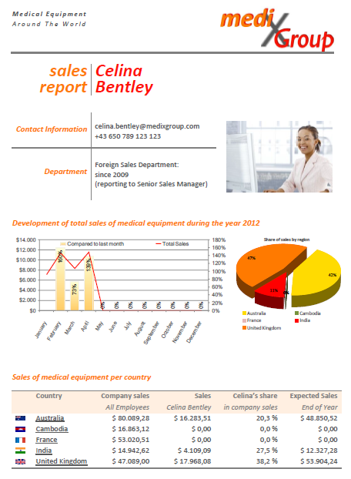



sms
Add-Ins
Users
Documents
Channels
Server
Unlimited
dox42 Server – generate documents from all applications
Notes:
ausschnitt = 5

Slide 14

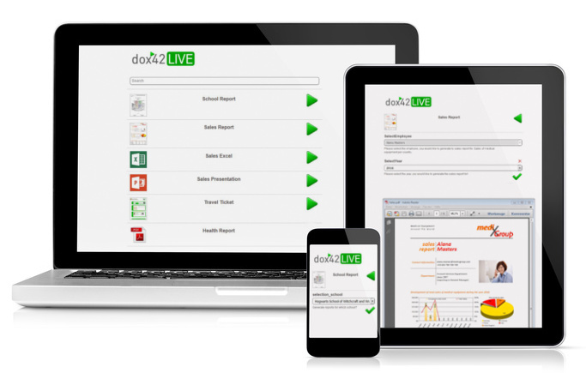
dox42 LIVE – mobile document creation
Notes:
ausschnitt = 5

Slide 15
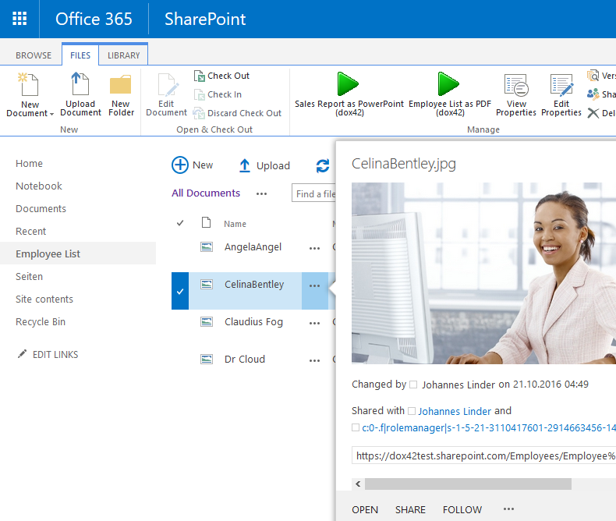
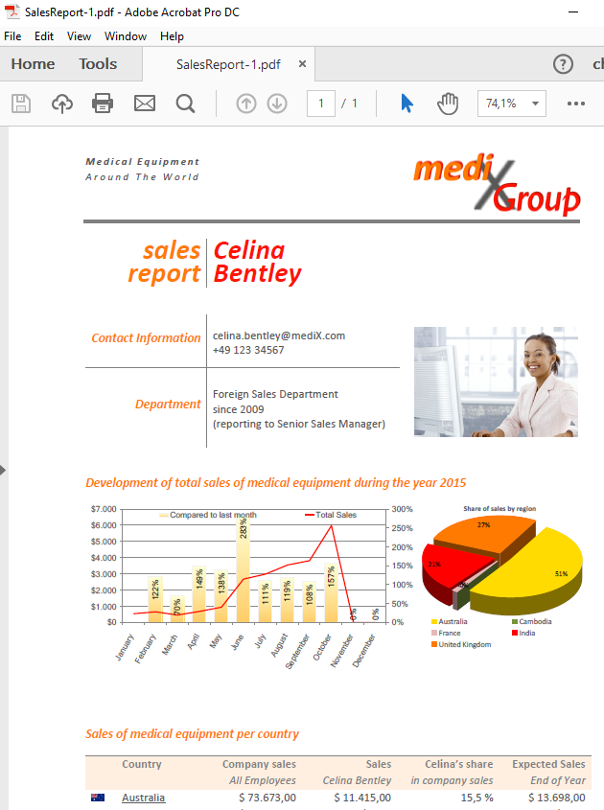
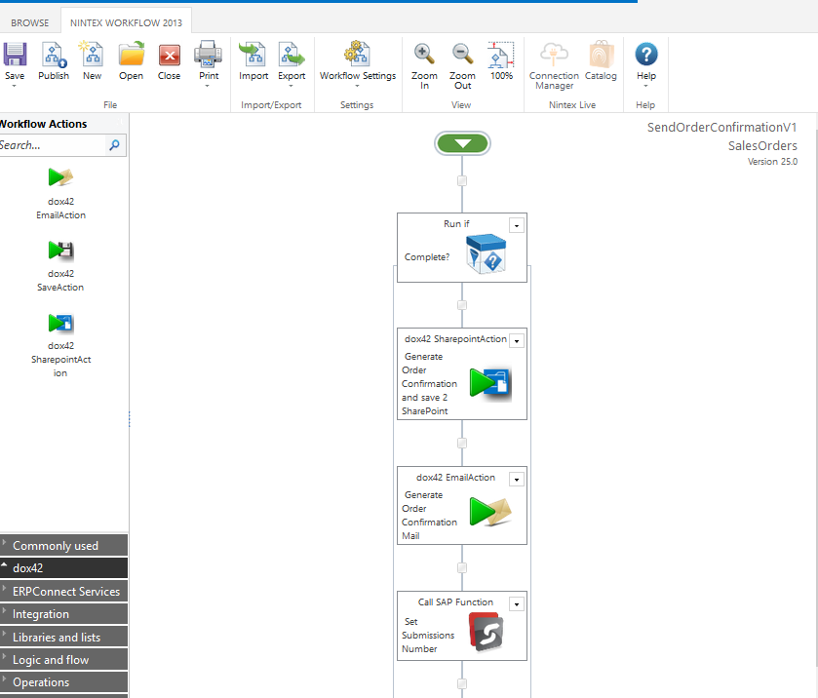
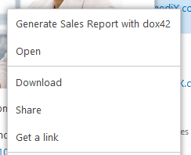
Office 365 SharePoint Online
SharePoint On Prem or Hybrid
Connect to all lists and documents from SharePoint
External data sources
PDF, Office formats
Write meta data
E-mails, print
Workflow integration
Generate documents from SharePoint

Slide 16

I save hours of time and I can concentrate on my core tasks again
Fantastic customized & individual documents
Template design independent from applications
Response to market trends and chances quickly
Individual customer communication digital and automatic
No more mistakes
I love doing my work this way again
And what benefit is it providing for me?
Notes:
schrift

Slide 17





dox42 technology partners

Slide 18

































dox42 Case Studies

Slide 19
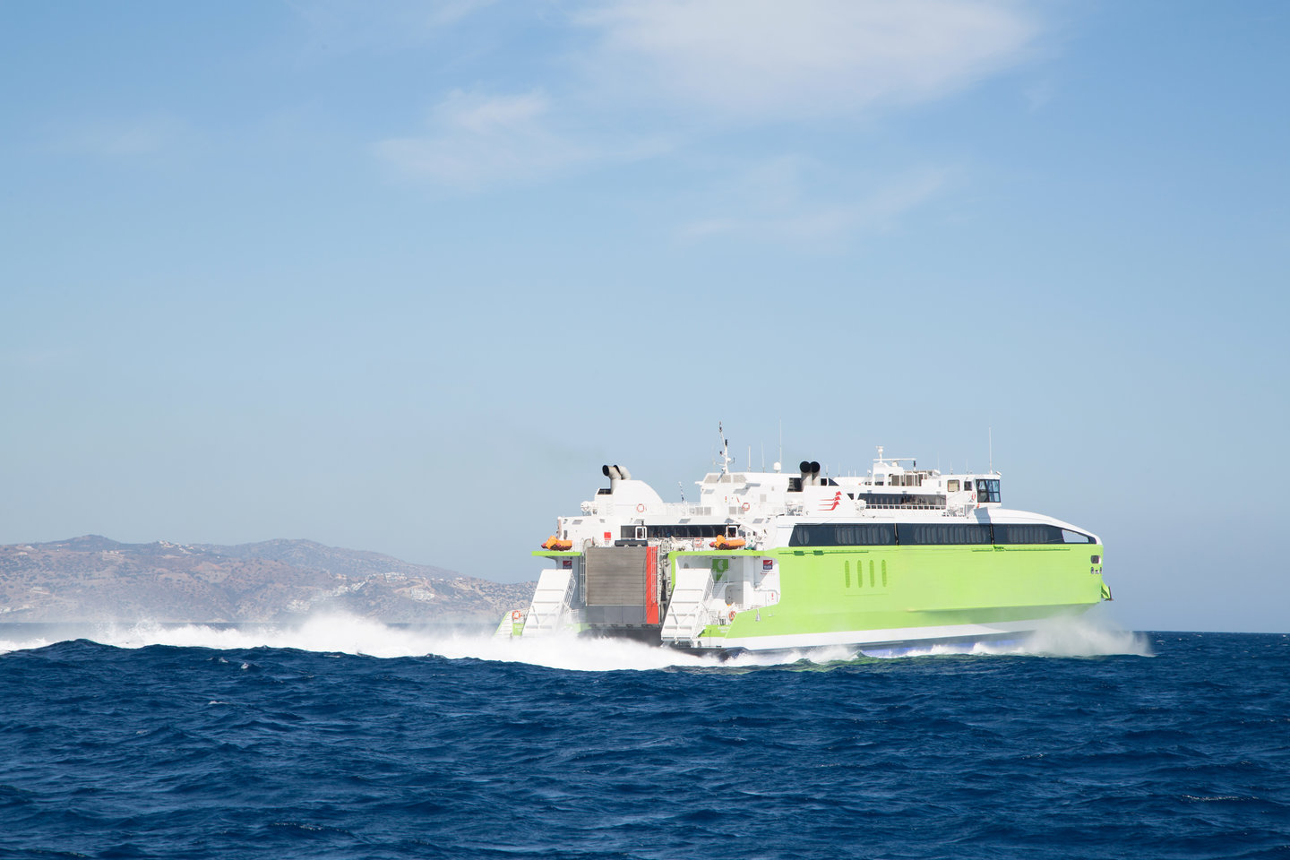




Companies in Manufacturing automate Documents with dox42
“Currently dox42 is utilized as document generator in our global sales and service platform that is based on Microsoft Dynamics CRM. We are generating sales quotes, fully automated high quality
service reports and additionally
we use the dox42 Excel automation
for our new service product
“Lifecycle-Care”.“
Marc Rieger Business Process Representative
Offers, Orders, Invoices
Quality and Audit Reports
Waybill with Barcodes
Sales Presentations
Project Management Reports
Employment Contracts
And much more

Slide 20

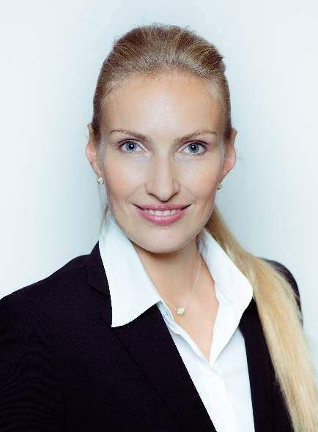


Fast and reliable - dox42 for Retail and Food
„In our business we produce documents day after day, which have to be verified and filed by various authorities. Therefore, reliability was the highest priority for our new document workflow solution.
Break-Even Point was reached after four weeks"
Elena Schneider IT - Project Manager
„As part of the ERP System integration, dox42 provided a solution for generating documents and for various business departments to easily edit the document templates. dox42 has proven
to be really effective, which
is why we will continue to
use the solution for generating
our documents.“
Benjamin Biendara Business Analyst

Slide 21
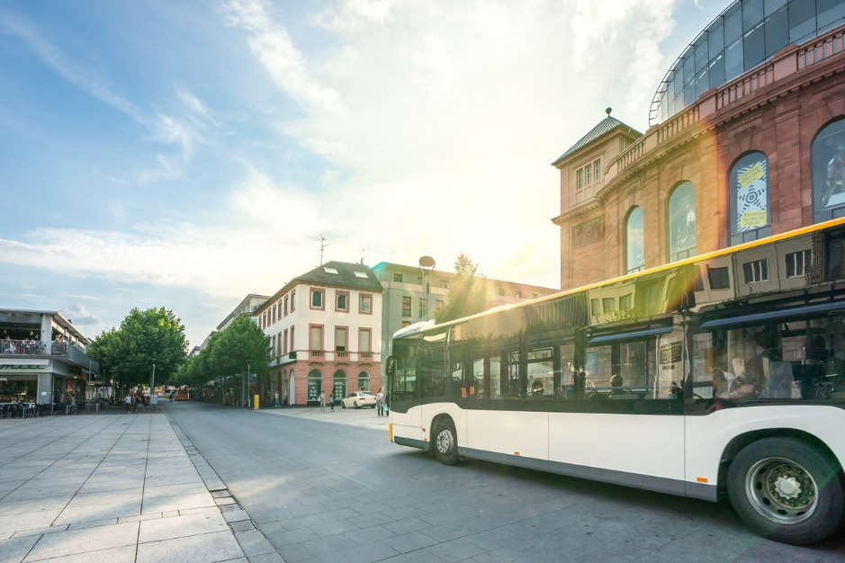










Hassle-free Document Automation for the Public Sector: dox42
„From now on, our employees don’t have to worry about the structure and design
of documents, they
can rather focus on the
essential contents.“
Michael Lamatsch Vice Town Clerk
Contracts
Employment Contracts
Certificates
Legal Documents
Permits
And much more
f

Slide 22





Intelligent Automation for Finance with dox42
Financial Investment Proposal as PowerPoint
Contracts, Rental Contracts, Employment Contracts
Depot Evaluation
Financial Reports
Insurance Policy,
Real Estate Valuation
And much more
„dox42 has quickly established itself as useful and practical tool for the creation of validations and contracts for our customers within
the Volksbank South Tyrol and
it´s even fun to work with.”
Stefan Runggatscher Information Systems Data Management

Slide 23


Intelligent Automation for Finance with dox42
Financial Investment Proposal as PowerPoint
Contracts, Rental Contracts, Employment Contracts
Depot Evaluation
Financial Reports
Insurance Policy,
Real Estate Valuation
And much more
„Quality throughout all customer processes is crucial to BonusCard.ch AG. With dox42, BonusCard.ch AG is able to react to changing customer needs flexibly and without great effort. Furthermore, the introduction of dox42 enabled the team leaders to edit existing and even create new standard letters in no time..”
Lucas Fierz
Head Solution Design & Technology

Slide 24



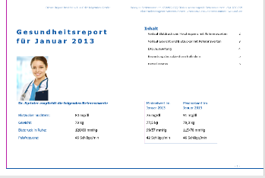
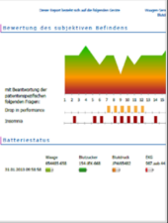


dox42 is just right for Health Care
„Up until now, requirements were fulfilled by programming. Changes in the layout were only possible through the development department. With the use of dox42
it is now possible to integrate various
documents and create the necessary
templates intuitively and quickly in
MS Office. It has required a minimal
amount of effort to master dox42. “
Daniel Schmid Group Leader Integration IT-Services
Health Reports
Patient Letters
Care Documentation
Project Management Reports
Employment Contracts
And much more

Slide 25


LIVE DEMO

Slide 26



WEBINAR
Create documents that add value from MS Flow
Johannes Linder, Lead Technical Evangelist at dox42
Lisa Pulsinger, Business Technology Evangelist at dox42
November 27, 2019 10:00 AM – 10:30 AM CET
REGISTER NOW →

Slide 27

Q & A
Any Questions?

Slide 28
SharePoint Document Automation in the cloud Generate PDFs, Words, Presentations and Mails the way you love it!
Christian Bauer CEO | Software Architect | Denise Valentin Business Technology Evangelist

Slide 29



























































dox42 Partner

Slide 30


Need further information?
Visit our website: www.dox42.com
Drop us an email: info@dox42.com
Also request your free trial
www.dox42.com
Christian Bauer CEO | Software Architect | Fabian Huber Business Technology Evangelist

